Slide 1
Introduction to the IRAP Part 2: Clinical Applications
NUI Maynooth, Ireland
Ciara McEnteggart, Emma Nicholson,
Yvonne Barnes-Holmes and Dermot Barnes-Holmes

Slide 2
Overview of Workshop
Outline on each IRAP
Comments on design and results obtained
Design your own IRAP
Q&As.
Clinical IRAPs: Published and Unpublished
Self-Esteem
Depression
Spider Fear
Disgust and OCD
Thought Suppression and Acceptance
Stigmatisation
Sex Offending
Cocaine Dependance
Weight
Eating Disorders
Smoking

Slide 3
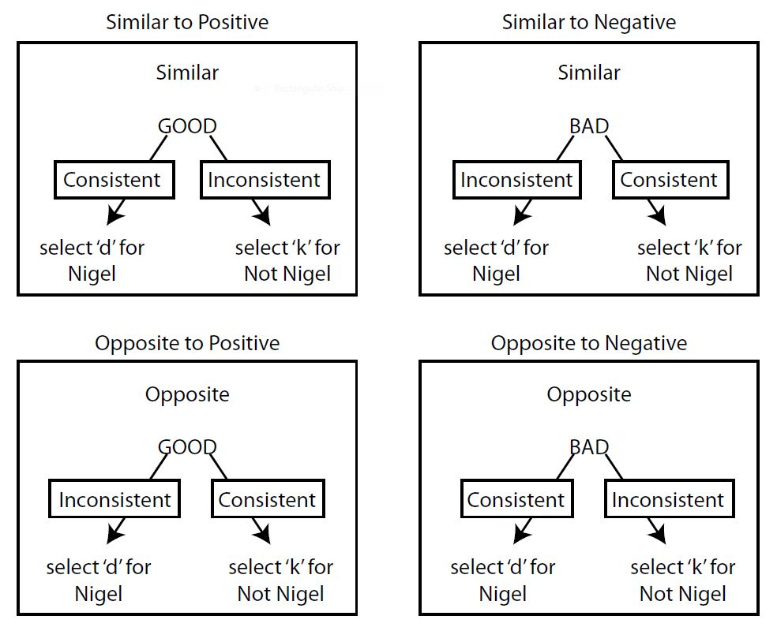
Self-Esteem
Vahey, Barnes-Holmes, Barnes-Holmes & Stewart (2009)
Participants consisted of undergraduates and 2 sets of convicted prisoners
Overall D-IRAP score correlated significantly with a feelings thermometer (r= .34, p = .024)
Students and prisoners in the open area block produced stronger effects than the main block prisoners
70% accuracy

Slide 4
Self-Esteem
Overall D-score correlated with Rosenberg Self-Esteem Scale (r = .65, p < .01)
80% accuracy, 3000ms

Slide 5
Self-Esteem
No significant correlations with explicits found.
80% accuracy, 3000ms

Slide 6
Self-Esteem
Overall D-score correlated with Rosenberg Self-Esteem Scale (r = .46, p < .05)
80% accuracy, 3000ms

Slide 7
Comments
Each study confirmed the hypothesis that people tend to view the self as positive
It appears that when measuring self-esteem it is important to focus on the self only and not others
Regarding the study by Vahey et al. (2009), the use of the self (i.e., name/I am) as the response option may be challenging for participants so it may be helpful to use the self as the sample or target
Highlights that criterion on the IRAP should be achieveable for participants, so trial runs are important

Slide 8
Depression
Hussey & Barnes-Holmes (in press)
No significant difference in D-IRAP scores between a high and low depressive group at baseline
Following a sad mood induction, the high depressive group produced a significant decrease in implicit positive emotion while the low depressive group did not (t(28) = 2.05, p = 0.05 ).
80% accuracy, 3000ms

Slide 9
Depression
Participants more readily responded to the self as non-depressed
Overall D-score did not correlate with explicit measures (p’s > .5)
80% accuracy, 4000ms

Slide 10
Comments
With a construct as complex as depression, capturing the conditional beliefs which characterise depression is vital so appropriate stimuli selection is critical
Don’t be vague with the stimuli that you choose
Hussey & Barnes-Holmes (in press) is an example of an experimental manipulation (sad mood induction) which can alter D-IRAP scores

Slide 11
Spider Fear
Nicholson & Barnes-Holmes (2012)
Combined spider trial-types correlated with FSQ (r = .47, p < .01) while pleasant trial-types did not
Spider trial-types were a predictor of avoidance behaviour (B = –2.08, p = .02)
Example of a construct with no natural opposite to act as a comparison category
80% accuracy, 2000ms

Slide 12
Spider Fear
Spider trial-types were not correlated with the FSQ (r = .04)

Slide 13
Spider Fear
Spider Trial-types did not correlate with FSQ in 3 different studies (r’s = .2)
Overall D-IRAP score was predictive of avoidance behaviour (B = –2.17, p = .02)

Slide 14
Comments
IRAP’s with pictures appeared to capture spider fear more successfully by increasing the valence of the stimuli (i.e., correlation with avoidance behaviour)
Including a behavioural measure if useful for further validating IRAP

Slide 15
Disgust and OCD
Nicholson & Barnes-Holmes (2012)
Attempted to measure 2 points of the same response with 2 IRAPs
The initial feeling (disgust propensity) and the appraisal (disgust sensitivity)
Disgust Propensity: 80%, 2000ms

Slide 16
Disgust and OCD
Neither correlated with disgust scales but both correlated with measures of OC tendencies
DS predicted avoidance behaviour while DP did not
Disgust Sensitivity: 80%, 2500ms

Slide 17
Disgust and OCD
Measured obsessive beliefs (i.e., responsibility, threat, intolerance of uncertainty etc) in response to disgust, rather than disgust responses
D-IRAP score correlated with the obsessive beliefs questionairre (r = .48, p < .05)
80% accuracy, 2000ms

Slide 18
Comments
Each study utilized a single trial-type in the results, the disgust/negative trial-type
Highlights the use of individual trial-types
Using pictures in the IRAP was once again successful to enhance the valence of the stimuli

Slide 19
Thought Suppression & Acceptance
Participants produced longer latencies on inconsistent relative to consistent
This suggests that people are more likely to suppress negative thoughts and embrace positive thoughts
No differences between experience with acceptance groups (No experience, Limited experience, Considerable experience)

Slide 20
Comments
Example where vague stimuli can produce few meaningful results
Use of therapeutic language may have hindered participant responding due to limited understanding

Slide 21
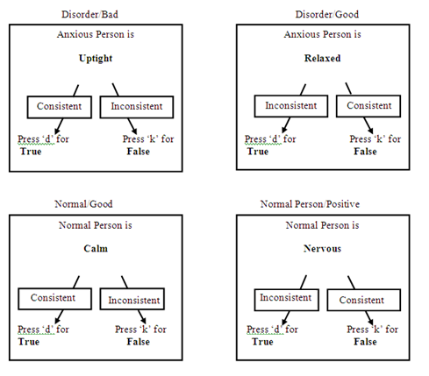
Stigmatisation
Stigmatising attitudes towards people with psychological suffering.
Pro-normal/anti-disorder bias in the Disorder-Bad trial-type
Correlations with explicits
80% accuracy and 2000ms Latency

Slide 22
Comments
Specific Populations
Individual trial-types again important here
Self-stigmatisation of individuals diagnosed with ‘disorders’ can also be measured if the IRAP is tailored to the ‘self’ and ‘others’

Slide 23
Sex Offending
Dawson et al. (2009)
Sex-Offenders ability to discriminate between children and adults as sexual was signficantly impaired in the Child-Sexual trial-type (D ≈ 0)
Discriminant Analysis predicted outcomes for 69% of sex-offenders
No correlations with CDS, previous offenses, treatment effect or education
80% accuracy, 5000ms latency

Slide 24
Comments
Another example where individual trial-type is important
The very low D-IRAP score for the Child-Sexual trial-type indicated impaired view of children as sexual (i.e., no effect does not mean no result!)

Slide 25
Cocaine Dependence
Carpenter et al. (2011)
IRAP used at two phases over treatment

Slide 26
Cocaine Dependence
Phase 1 of treatment (1-12 weeks)
D-scores were correlated with treatment outcomes during the first 12 weeks of treatment
strongest for ‘with cocaine positive’ and the ‘with cocaine negative’ trial types
Stroop Interference, CEQ, and CCQ scores were not correlated with treatment outcome during phase-one of treatment.

Slide 27
Cocaine Dependence
Phase 2 of treatment (13 to 24 weeks)
greater cocaine use in phase two of treatment was associated with a stronger pro-cocaine belief on the with cocaine-positive IRAP trial types
significant correlations between IRAP D-scores for the ‘with cocaine positive’ trial type and Stroop interference scores
No correlations with explicits

Slide 28
Comments
Example of a simple IRAP with meaningful stimuli
Importance of individual trial-types

Slide 29
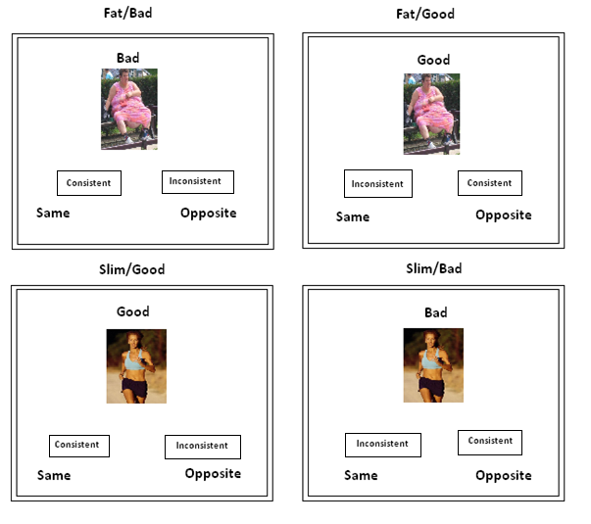
Weight
Roddy et al. (2010)
Pro-Slim bias found
No correlations between the D-Score and the AFA nor did it predict behavioural intentions

Slide 30
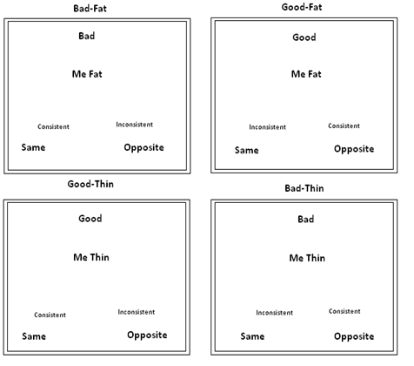
Eating Disorders
Parling et al. (in press)
Anorexia Nervosa (AN)
Four IRAP conditions targeting: (1) SELF (see right), (2) OTHERS, (3) THINNESS and (4) FATNESS
SELF IRAP
Good-MeThin (pro-thin attitude) significant for AN group
Significantly stronger anti-fat attitude on the Bad-Me Fat trial-type for AN group
75% accuracy, no latency criterion

Slide 31
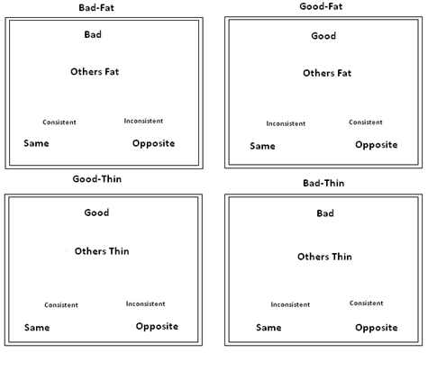
Eating Disorders
OTHER IRAP
Significant Pro-Fat bias for AN group in the Good-Others Fat trial-type

Slide 32
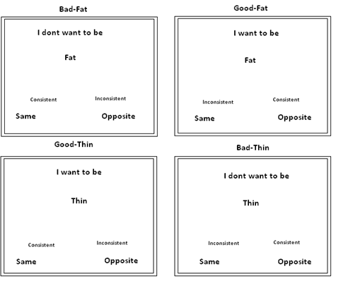
Eating Disorders
THIN IRAP
AN group showed significantly stronger anti-fatness bias on the Bad-Fat (i.e., ‘I don’t want to be Fat’ trial-type).

Slide 33
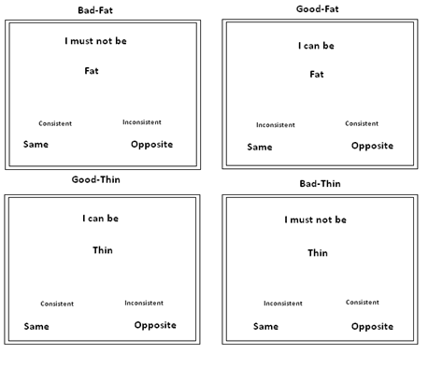
Eating Disorders
FAT IRAP
Significant pro-thinness attitudes
‘I must not be thin’ and ‘I can be thin’ significant for AN group
Overall, Stronger striving for thinness compared to avoiding of fatness
No correlation between explicit VAS ratings and trial-types except in the Fat-IRAP trial type “I can be fat” and the corresponding rating on the explicit VAS measure “I can be fat” – “I must not be fat” in the AN group

Slide 34
Comments
Increased number of IRAP facilitates more questions i.e. Is it avoiding fatness / striving thinness? Does this just apply to themselves or stretch to others.
Allows for specificity to provide a greater picture of the cognitive mechanisms at work
Thin and Fat IRAPs is an example of higher complexity

Slide 35
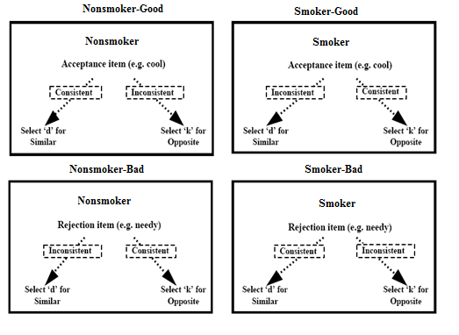
Smoking
Vahey et al. (2010)
N = 16 (8 smokers, 8 non-smokers)
Preparation IRAP prior to Smoking-IRAP
Stronger D-Score in Smoker-Acceptance trial-types for the Smoker group (D=0.21)
70% accuracy

Slide 36
Smoking
Smokers had a pro-smoking bias i.e., smokers related social acceptance with smoking. Non-smokers did not.
Contributes to smoking susceptibly
Verbal history of the participants might not necessarily have derived any evaluative bias on the topic (i.e., Nonsmokers’ biases)

Slide 37
Comments
Small N limits conclusions
Sampling methods should be refined (e.g., are non-smokers ex-smokers etc.)...verbal history!
Preparation IRAP not always necessary but can be useful to familiarise participants with the task
Importance of Latency and Accuracy during practice blocks

Slide 38
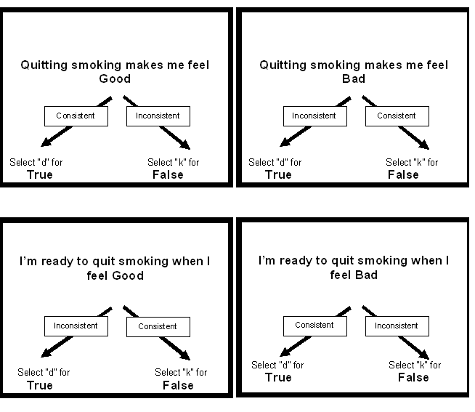
Smoking Intervention
Vahey et al. Extended previous research to change attitudes
Measured attitudes towards quitting smoking
Trial-Types: Quitting Feels Good (Gain)
Quitting Feels Bad (Loss)
Ready when I feel Good (Gain)
Ready when I feel bad (Loss)

Slide 39
Smoking Intervention
3 intervention methods:
(1) acceptance,
(2) avoidance and
(3) placebo

Slide 40
Smoking Intervention
Acceptance Intervention
encouraged participants to deliberate about message content in a non-disputative manner incorporating their personal values
Avoidance Intervention
the corresponding avoidance videos essentially encouraged participants to engage in disputation of the message content whenever they felt it upset them pointlessly

Slide 41
Smoking Intervention
IRAPs before and after quitting
both trial-types (i.e. Gain and Loss) in the acceptance conditions, successfully introduced a favourable implicit attitude of the immediate prospect of quitting where none existed at baseline.
75% of Loss-Acceptance Group agreed to return for a 30 minute video intervention to support their quitting

Slide 42
Comments
Trial-Types useful when designing intervention to see what aspect of behaviour requires targeting, e.g., Quitting Smoking is a Loss
Example of a perfectly designed IRAP and intervention

Slide 43
Designing your own IRAP
Choose the most accurate and simple sample and target stimuli which captures the construct you are measuring – the participant must be able to do it! -> Look at explicit measures for ideas of stimuli
The relational response options must be salient and simple
Use pictures is possible
Some samples have no natural opposite so it may be difficult to choose one e.g., phobias
Practice IRAP yourself first!

Slide 44
Administration of the IRAP
All IRAP data collection is done on a one-to-one basis and FAQ and Experimenter’s Script can be obtained by emailing us
Tell Participants the responding rule and explain the difficulty of the task
Don’t let participants sacrifice accuracy for speed (See FAQ sheet)
Attrition rates of >10% suggests that there is something wrong
Use Experimenter’s Script or contact Dermot.Barnes-Holmes@nuim.ie
Happy IRAPing ☺

Slide 45
Introduction to the IRAP Part 2: Clinical Applications
NUI Maynooth, Ireland
Email:
Ciara.Mcenteggart@nuim.ie
Emma.Nicholson@nuim.ie
Yvonne.Barnes-Holmes@nuim.ie
Dermot.Barnes-Holmes@nuim.ie

